Slide 1
Database Management
Systems
NoSQL
Doug Shook

Slide 2
Why NoSQL?
Better question: why relational databases?
1. a lot of resources based on relational db
2. the organizational structure is pretty simple and intuitive
Sadalage, Fowler, “NoSQL Distilled: A Brief Guide to the Emerging World of Polyglot Persistence” 2012
2

Slide 3
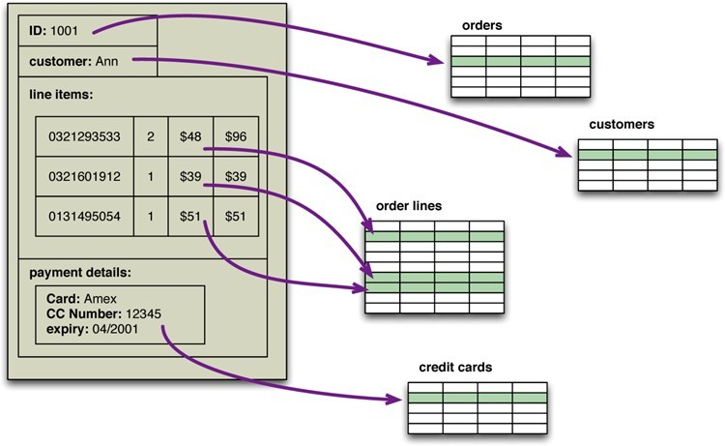
Problems with the Relational Model
Impedance Mismatch
3
Notes:
Break into chunks (table)
Stick them together when sql
“silly”
Relational: Normalization
NoSQL: Against Normalization

Slide 4
Application vs. Integration
What are you using the database for?
How does this effect...
Complexity? Integration more complex because of many data resources
Performance? Integration more difficult
Development? App more flexible
4
Notes:
Two type of Usages for Database: App vs. Integration
Relational: (Integration) taking data from multiple locations, aggregating it into one place
NoSQL: (Application) suit just one particular

Slide 5
The effect of scale
Consider how the internet looks now compared to 15 years ago....
– How did we come to meet the increase in demand?
1. To use computer that is more powerful;
2. Throw more databases to learn the communicator
* SQL DB cannot really erase this problem
5

Slide 6
Here comes NoSQL
s
What is it?
Not relational
How is it different?
To organize data differently based on larger documents
Why should we be using it?
NoSQL: application oriented
6
Notes:
Make a db that fits data well

Slide 7
Aggregates
How does a relational database store records?
– What are the limitations of this?
Table (rows and columns)
Takes some time to aggregate the data
7

Slide 8
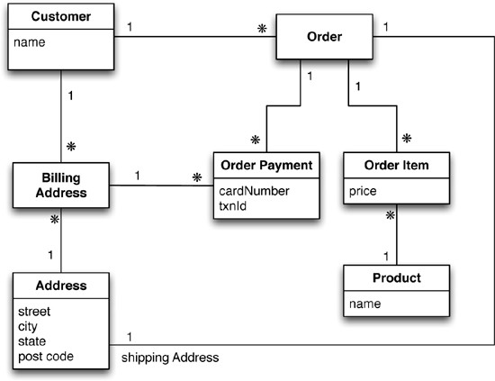
A relational data model
8
Notes:
order focus

Slide 9
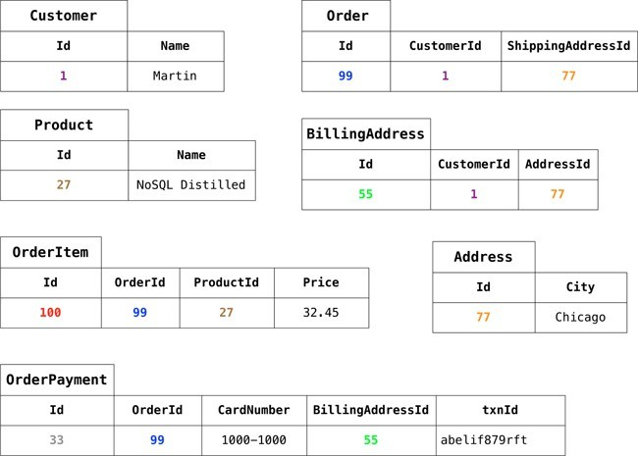
Relational data
9

Slide 10
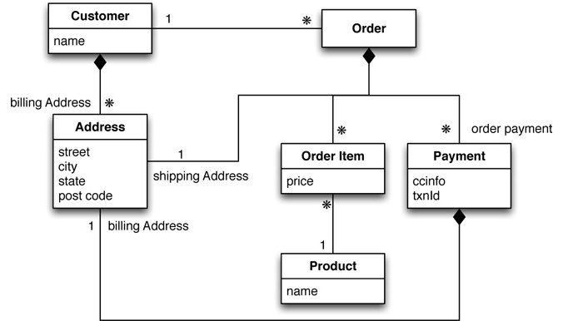
An aggregate data model
Notes:
Customer oriented

Slide 11
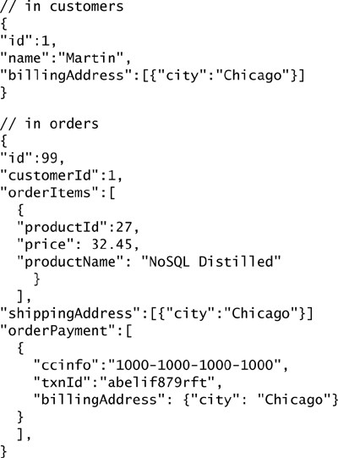
Aggregate Data
Notes:
JSON
If we want to find some specific products, not quite efficient

Slide 12
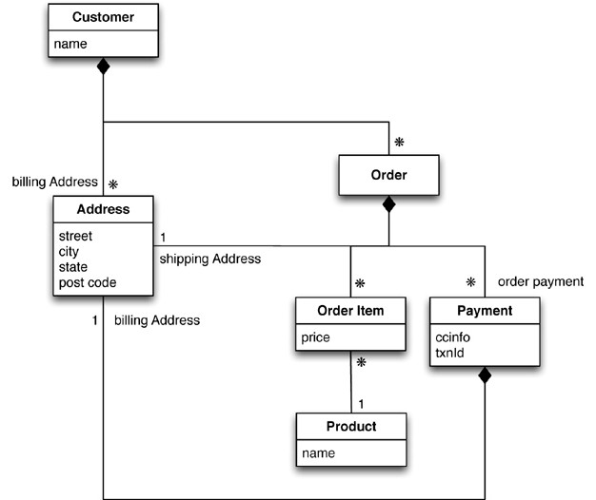
A different aggregate data model

Slide 13
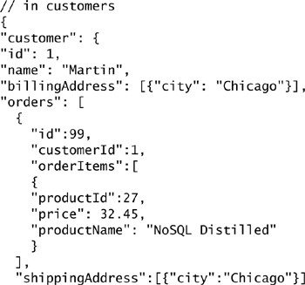
A different set of data
Notes:
If I don’t care about the order

Slide 14
Consequences
How are these aggregates represented in relational databases?
Join
What benefits are gained from using these aggregates in this way?
ACID Transactions (atomicity)
Notes:
We don’t have to do the relation. Like Foreign Key
Thus we don’t need transactions

Slide 15
Schemaless Databases
Under this model we do not require a schema
How is this possible?
Advantages?
Not check means a lot faster (no more validation)
Disadvantages?
Format
Are they actually schemaless?
No. implied schema. I need to make sure the db is in schema
Notes:
Schema: (the structure) what columns/tables exist, data types
Relation: before insertion, we check the scheme
“doesn’t care about ”

Slide 16
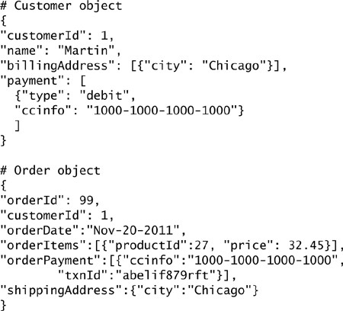
Modeling for Data Access
Notes:
Primary key has to be unique
“Referential Integrity”

Slide 17
Distribution
One of the major benefits of NoSQL (why?)
– Comes with one major drawback...
Notes:
Flexibility.

Slide 18
Single Server
Is this really distribution?
Yes (distributed)
Why might you want to do it this way?
Relational db for single server

Slide 19
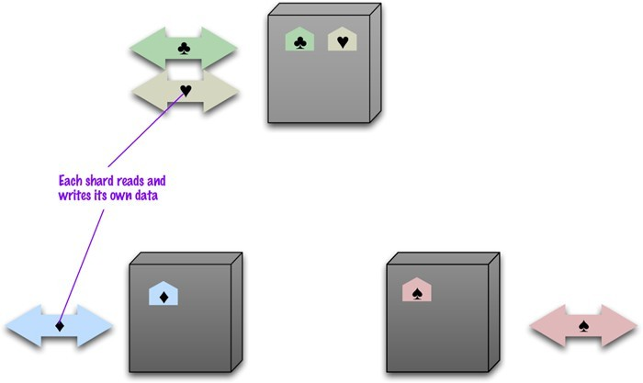
Sharding
Notes:
Sharding: takes data and spread it out across multiple places
(horizontal)

Slide 20
Sharding
What is the ideal case for # of users / servers?
How do we decide how to split up the data?
– What data will commonly be accessed together?
What can we use to help us perform these tasks?
Notes:
Relational db: Horizontal
Nosql: Split by documents and aggregates

Slide 21
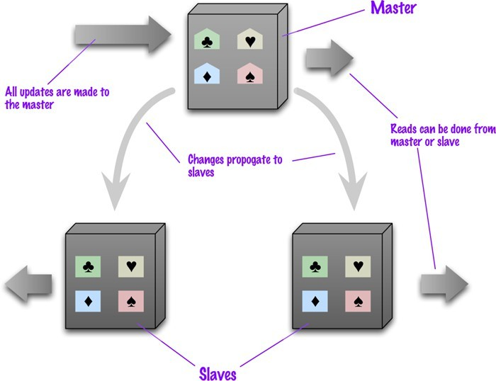
Master-Slave Replication

Slide 22
Master-Slave Replication
How does this affect performance of reads? Writes?
How does this affect data resilience?
What about consistency?
inconsistency exists

Slide 23
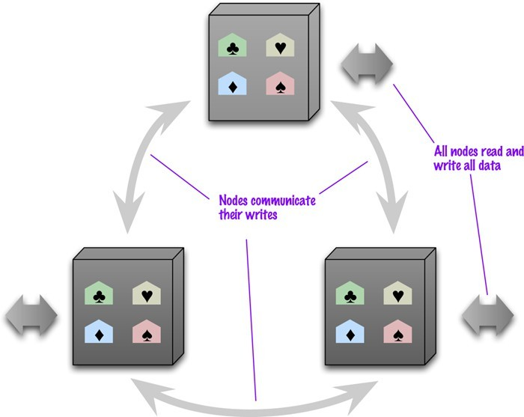
Peer-to-Peer Replication

Slide 24
Peer-to-Peer Replication
How does this affect performance of reads? Writes?
write/write conflicts
How does this affect data resilience?
What about consistency?
Notes:
Peer to peer is faster than master in terms of performance

Slide 25
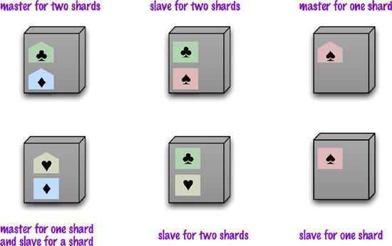
Combinations

Slide 26
Update Consistency
Imagine two people try to update the same piece of data at the same time(Write/Write conflicts - Transaction)
What happens?
What do we want to happen? (exam)
Pessimistic vs. Optimistic
- relational db is very pessimistic

Slide 27
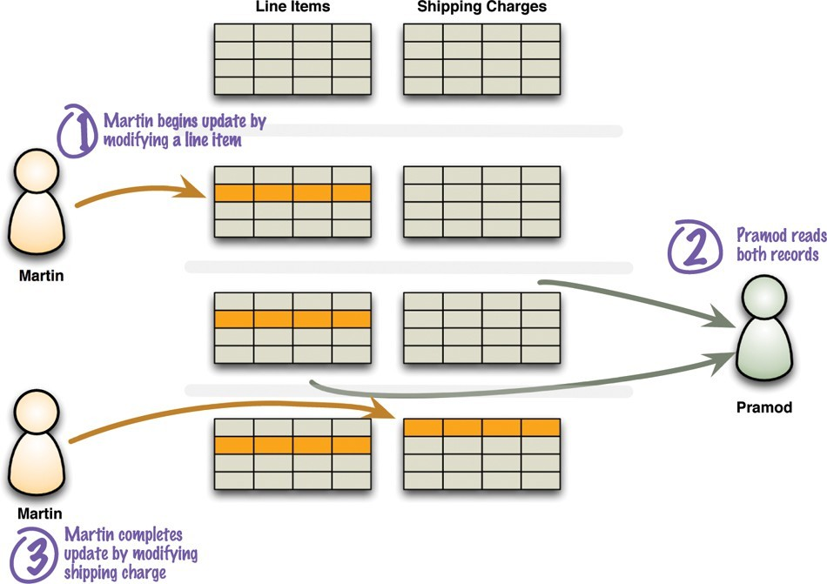
Read Consistency
If disagreement happens, just read again
2
7
Notes:
Temporary read problem (relational db doesn’t happen )

Slide 28
Read Consistency
Logical consistency
How do relational DBs handle this?
How does NoSQL handle it?(gamble, “trade-off”)
Inconsistency window
How does replication complicate this kind of consistency?
Notes:
Accept temporary inconsistent (less than a second)

Slide 29
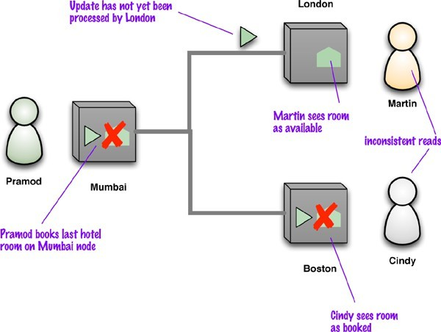
Read Consistency
Notes:
Overbook the flights is tolerable

Slide 30
Read Consistency
Read-your-writes consistency (read the same copy)
Session consistency (of the same server)
– Sticky Sessions

Slide 31
Relaxing Consistency
It is always possible to design a system that is consistent
– Why might we want to sacrifice this?
CAP Theorem
Consistency
Availability
Partition-Tolerance

Slide 32
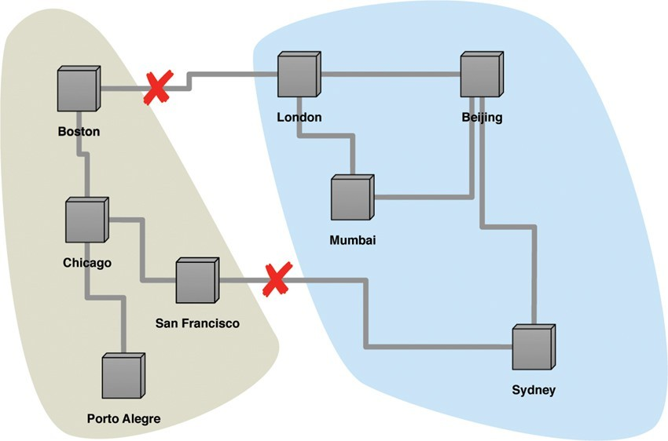
Partition Tolerance
Notes:
Split Brain Problem
If partition, still work for both parts

Slide 33
CAP Theorem
What is an example of a system without partition tolerance?
– Should we aim for this?
It is all about the trade off!
Notes:
We can pick 2 of three (C.A.P)
We must have p

Slide 34
CAP Theorem
How can we improve consistency?
Remove copies
How can we improve availability?
Add copies
Inconsistent writes
– What about reads?

Slide 35
Quorums
How many nodes do we actually need to get consistency?
Simple majority
Write quorums
Replication factor
3 (empirical)
How does this affect reads?
Notes:
Quorums 法定人数
If I have n in total, I need to at least n/2-1

Slide 36
Review
Notes:
The developer should enforce himself
Consistency, Availability, Partition-tolerance
2/3

